Slide 1
Talk
Chatting Application

Slide 2
Introduction
Teleconferencing or chatting, is a method of using technology to bring people and ideas “together” despite of the geographical barriers.
The technology has been available for years but the acceptance of it was quite recent.
This project is a web application which is hosted on the server computer of a network. The users are required to visit the website link on which the application is hosted in order to chat. Users can practice two kinds of chatting, public one (message is broadcasted to multiple connected users) and private one (between any 2 users only).
There is also a facility to share images, and audio files.
Typically, the user will first login or signup to the chat application. On successful login, the user reaches the main page. At this page, the user can select another user from recent chats list or from new users list for chatting.
After selecting user, he will be displayed with their older conversation, the user can now type message in the input box or can attach files and send them.

Slide 3
Problem definition And Objectives of Project
The chat application provides a platform for the clients/users to communicate with the other users and it gives a good user interface.
Communication over a network is one field where this tool finds wide ranging application.
Chat application establishes a connection between 2 or more systems connected over an intra-net or ad-hoc.
This tool can be used for large scale communication and conferencing in an organization or campus of vast size, thus increasing the standard of co-operation. In addition, it converts the complex concept of sockets to a user-friendly environment.
This application also provides facility to share files. This application can have further potentials, such as voice chatting and call facility options that can be worked upon later.

Slide 4
Existing System and Disadvantages of Existing system
There are many existing systems like WhatsApp, Instagram, Telegram and Facebook etc.
Storing/Retrieving the Chat-Backup may be messy and takes time.
While changing to a new device using the same number, the existing chat stored in the old device cannot be retrieved in this new device (in-case of not having chat backup).
Constant/Unwanted Messages like images and videos may eat all the space in the device.
No logout option is available.

Slide 5
Proposed System
Currently the present system holds the 256 members in the one group and we are proposing the system which can hold any number of members in the one group.
Logout option is available in the proposed system.
To maintain the system reliability and maintain the system to hold the multiple user at the same time.
User has the right to download the file automatically or manually as per his/her needs to save the storage and data.
No need to chat backup.
No need Download file local system.

Slide 6
Technology Requirements
IDEs - Visual Studio
Database – Firestore
Development Tool - Node JS
Programming Language - JavaScript
Framework – ReactJS

Slide 7
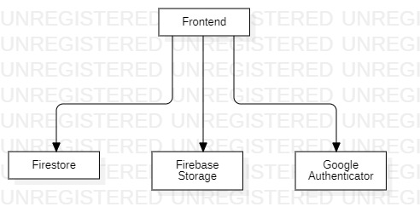
Model Diagram

Slide 8
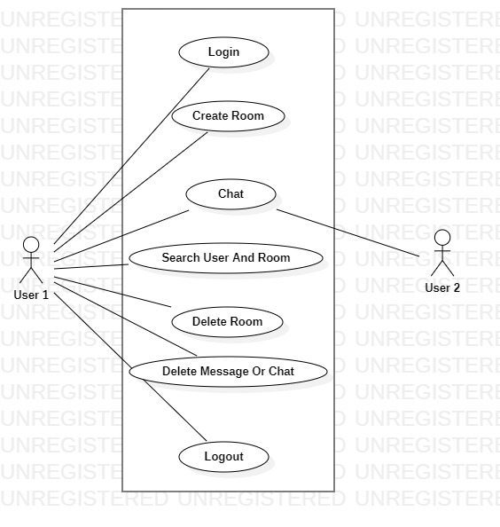
Use Case Diagram

Slide 9
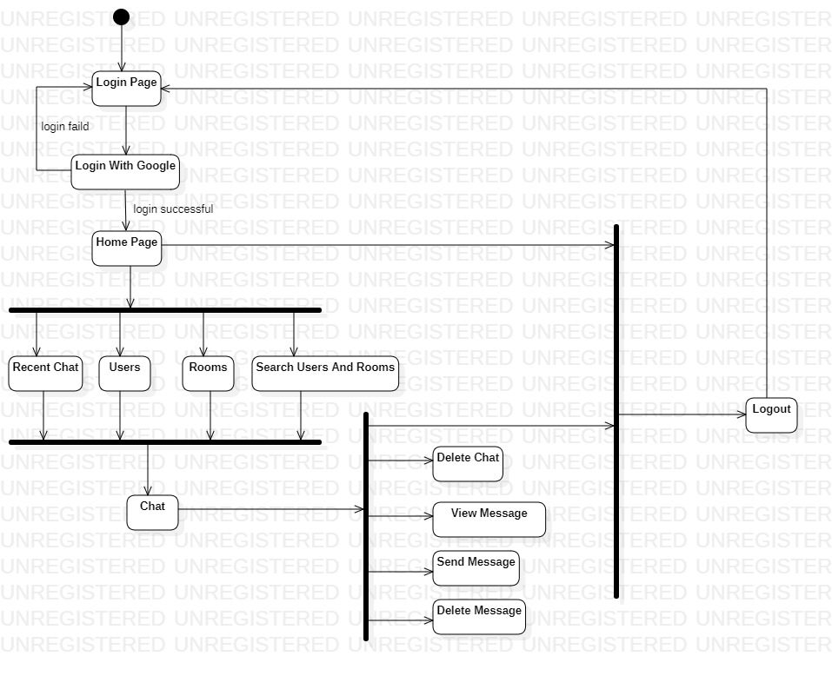
Activity Diagram

Slide 10
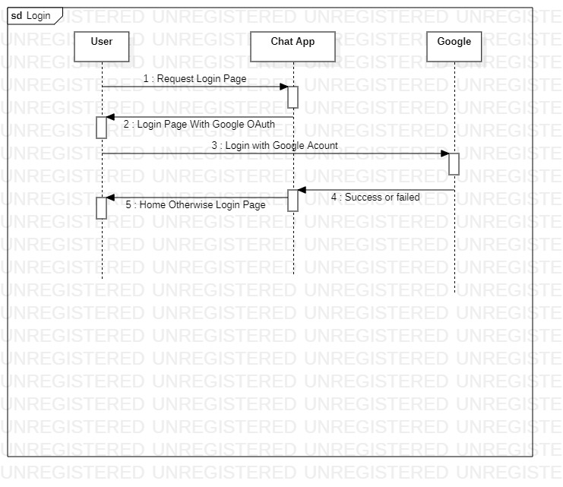
Sequence Diagram

Slide 11
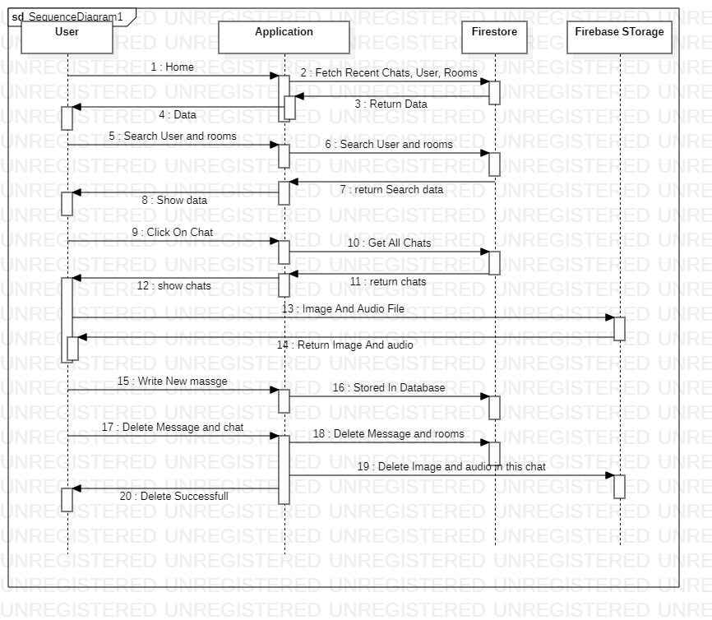

Slide 12
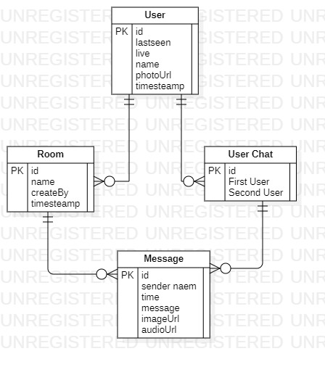
Entity-Relationship Diagram

Slide 13
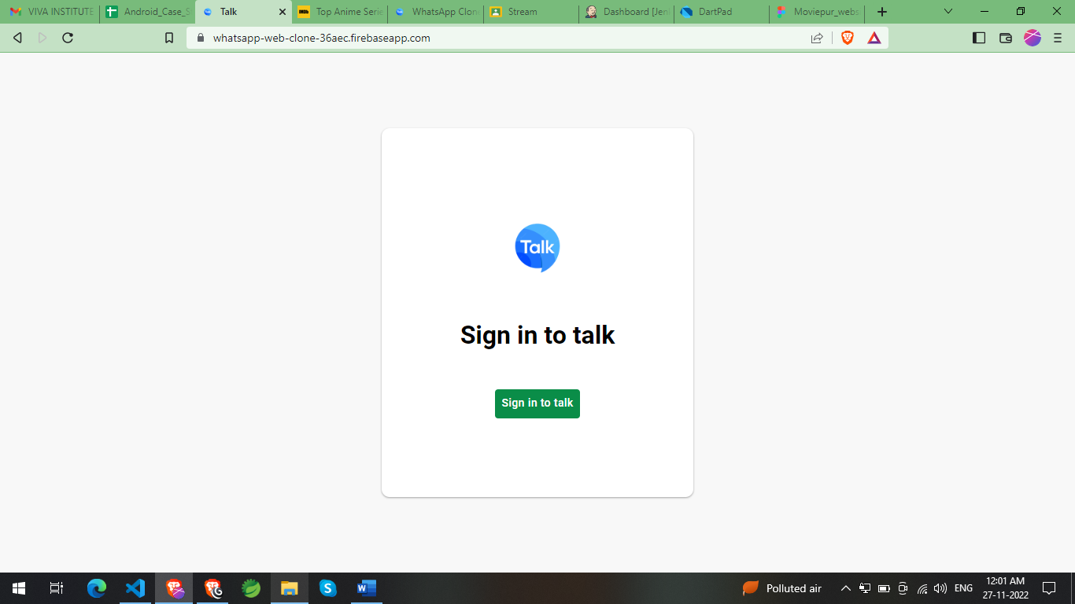
Login

Slide 14
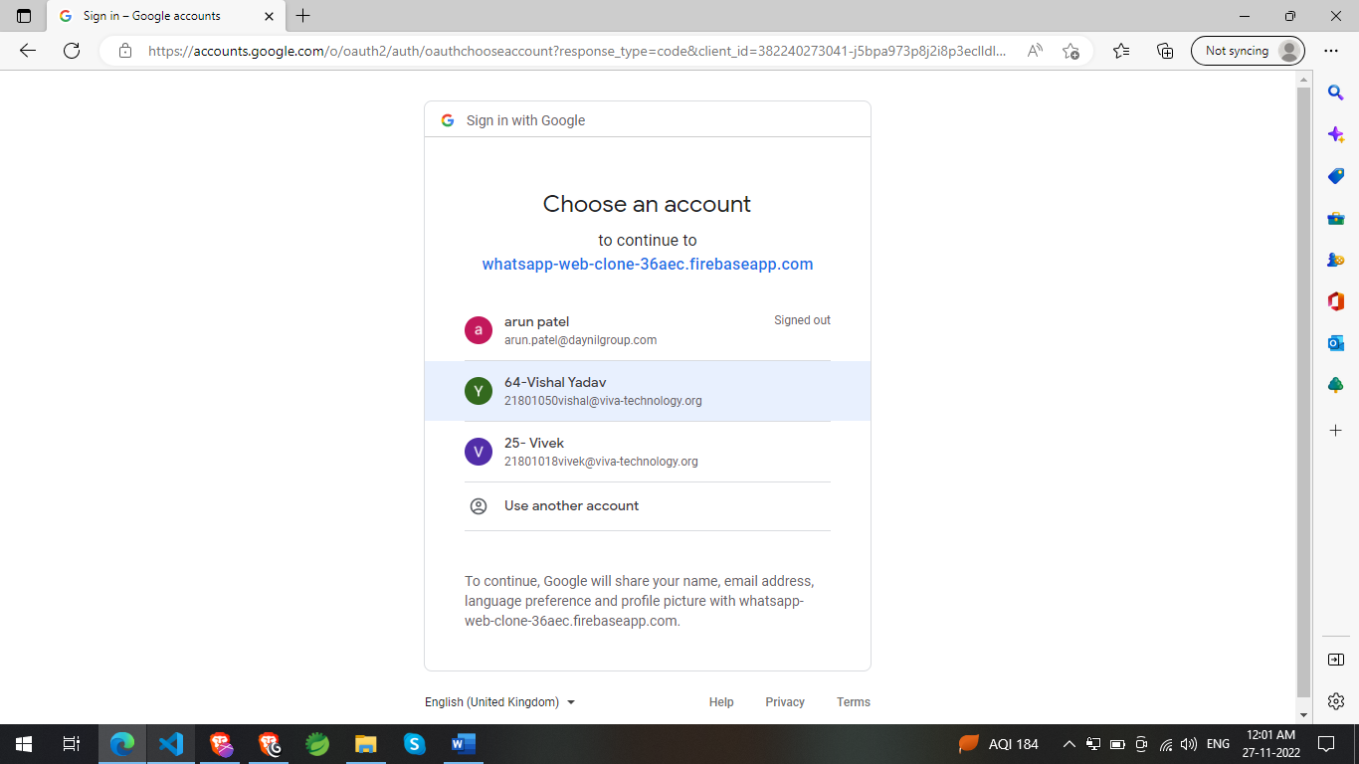

Slide 15
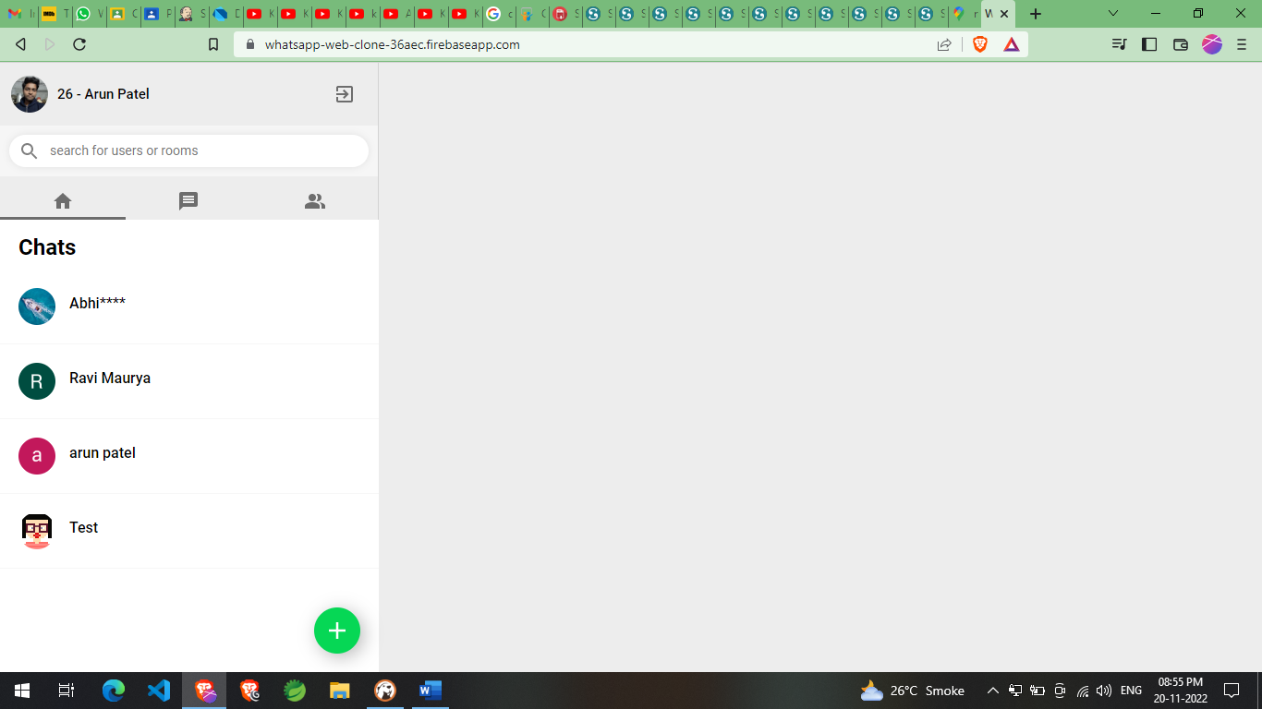
Home / Recent Chats

Slide 16
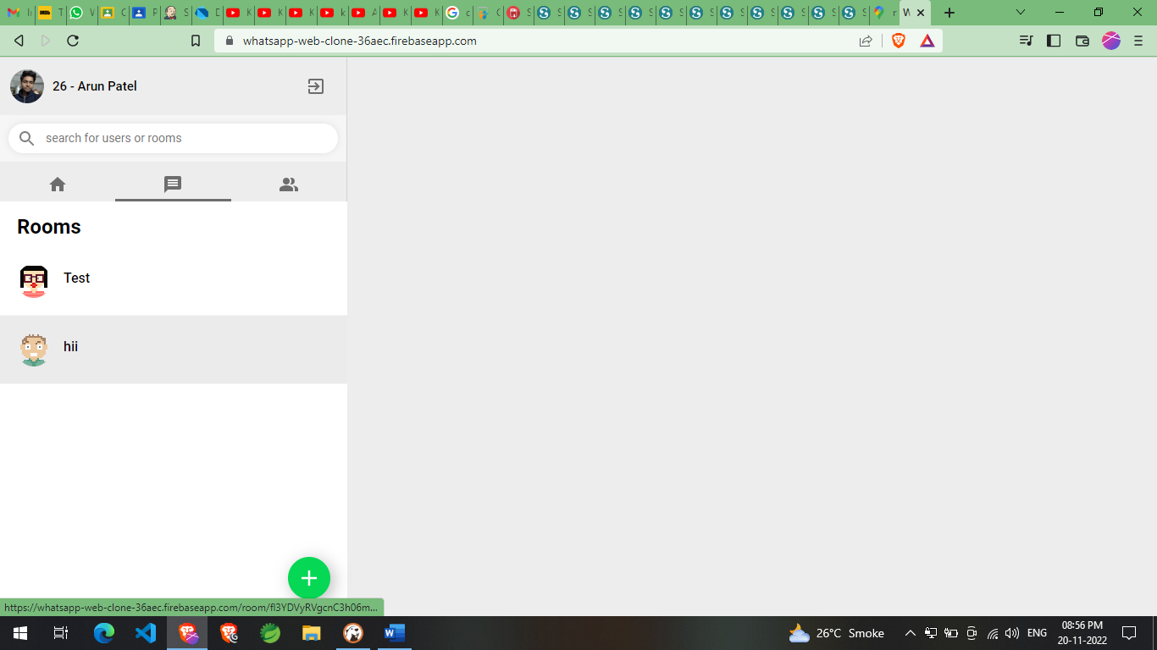
Rooms

Slide 17
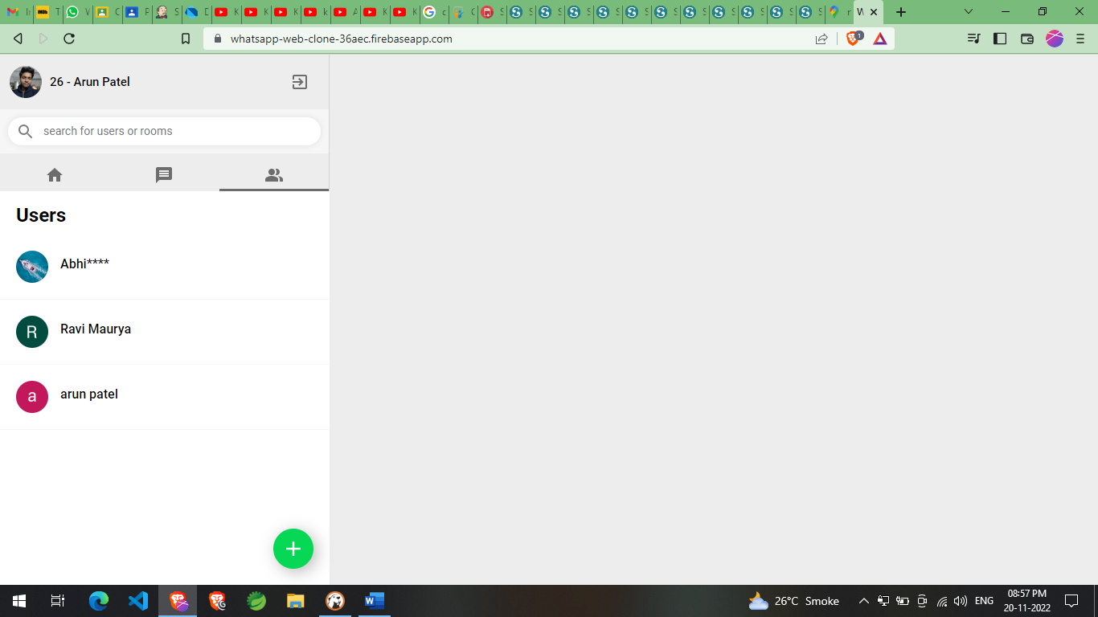
Users

Slide 18
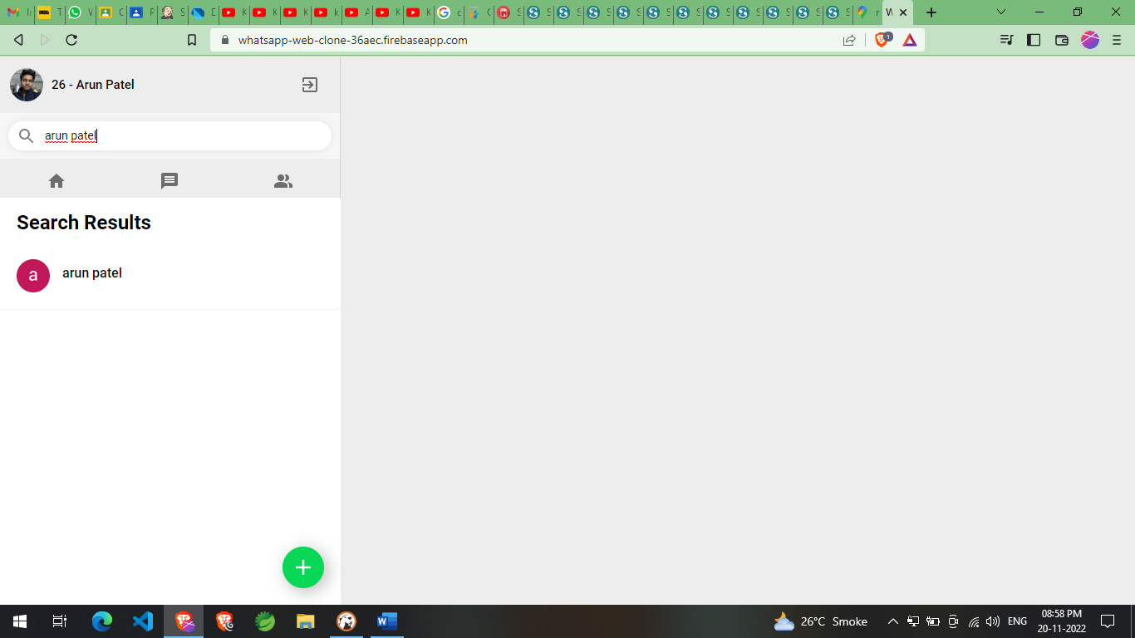
Search

Slide 19
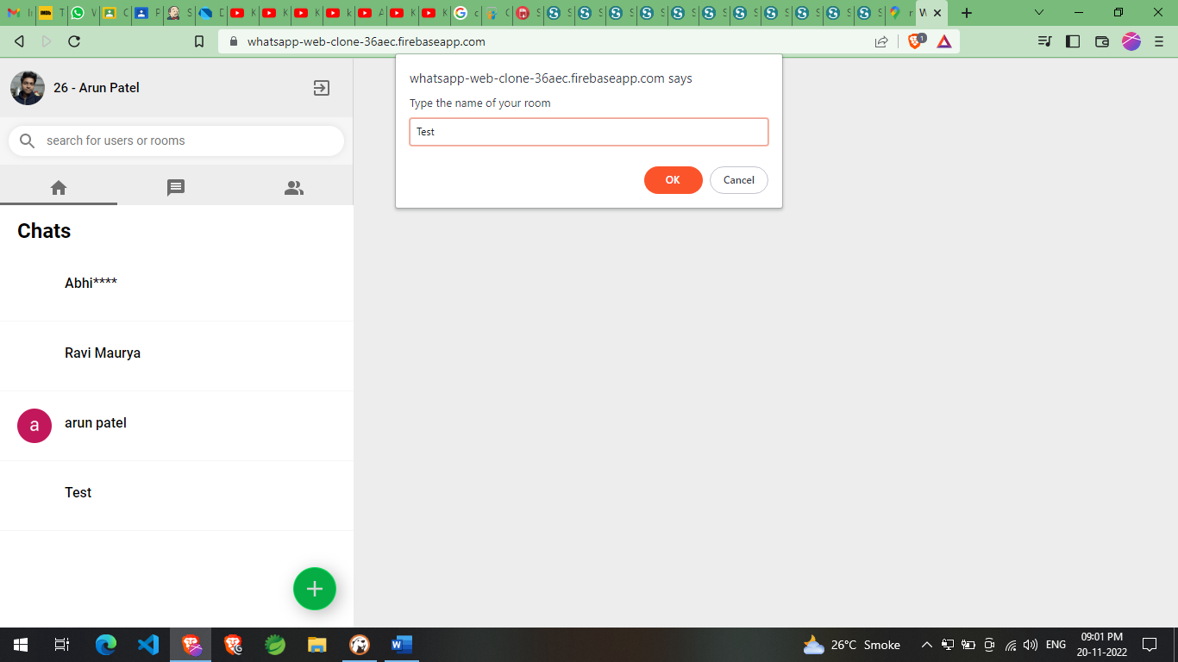
Create New Room

Slide 20
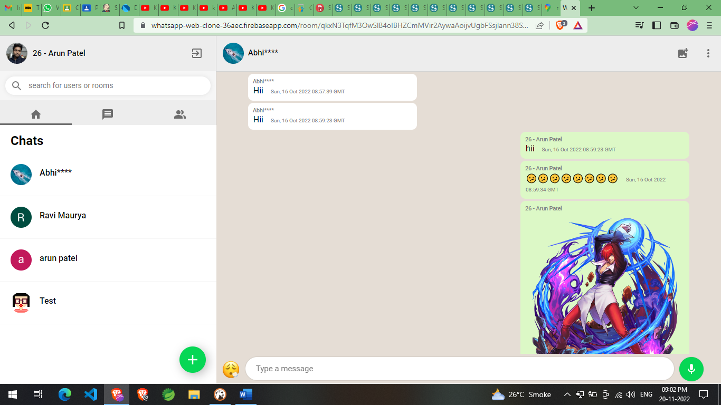
Chat Room

Slide 21
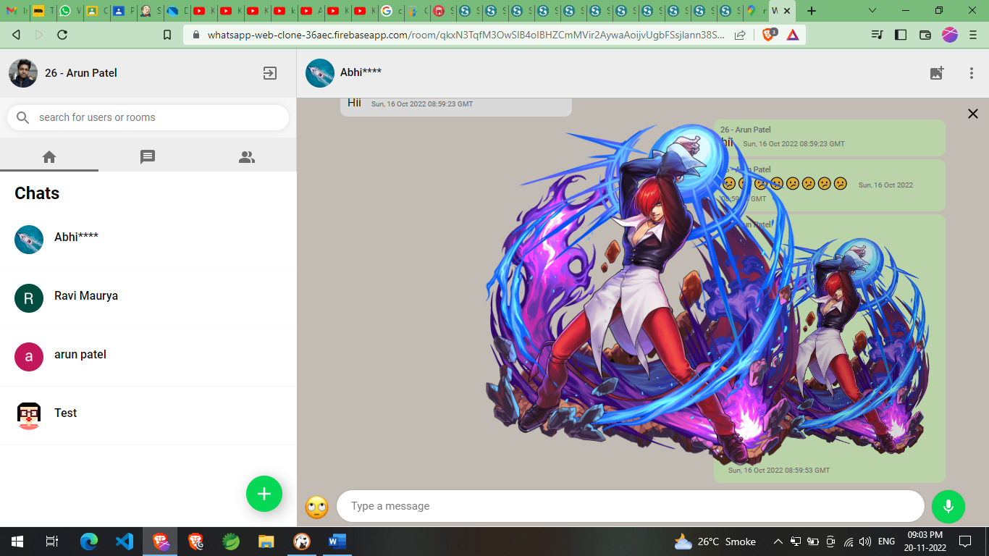
On Image Click

Slide 22
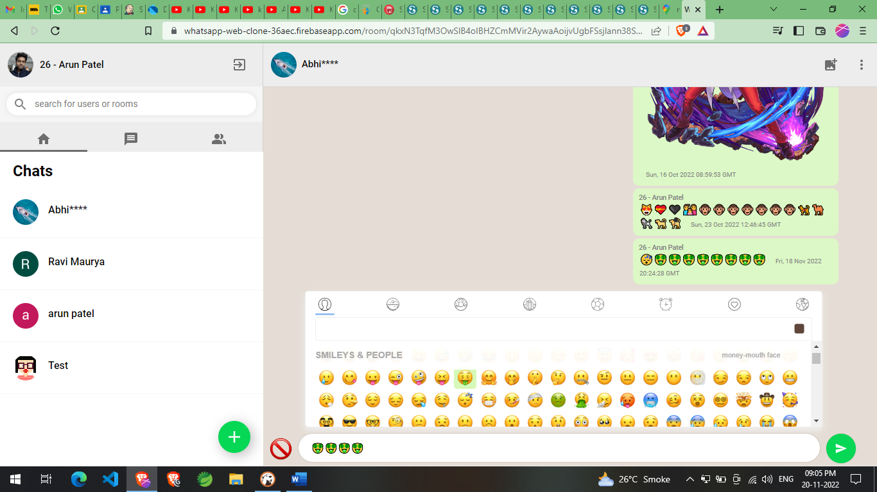
Emoji

Slide 23
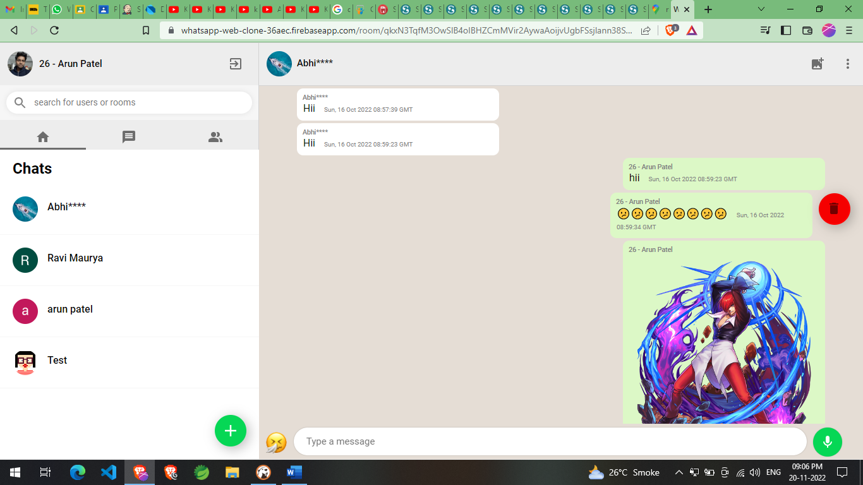
Delete Message

Slide 24
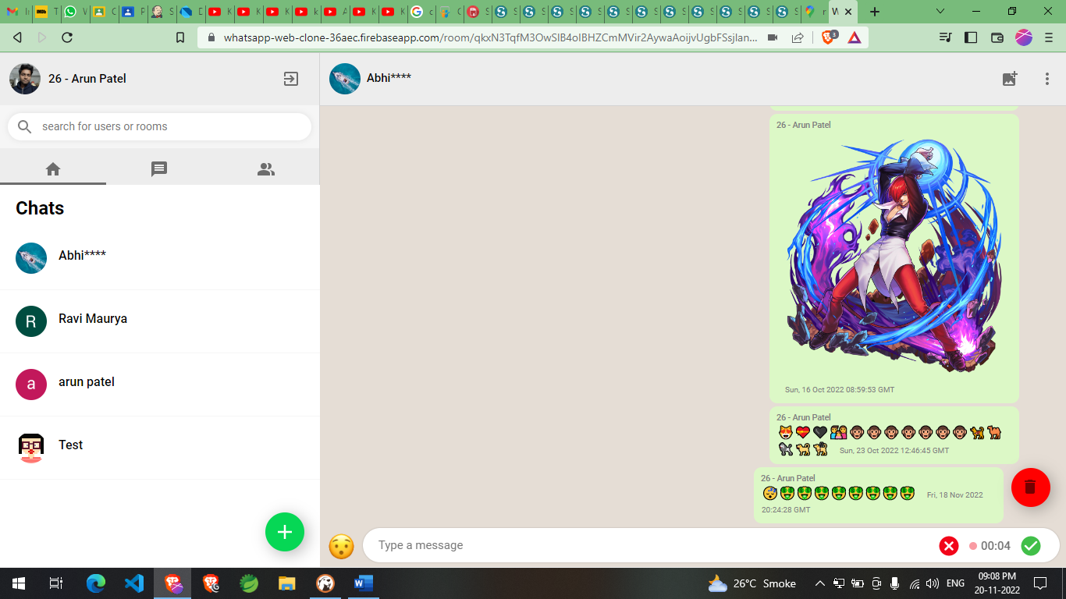
Audio Recorder

Slide 25
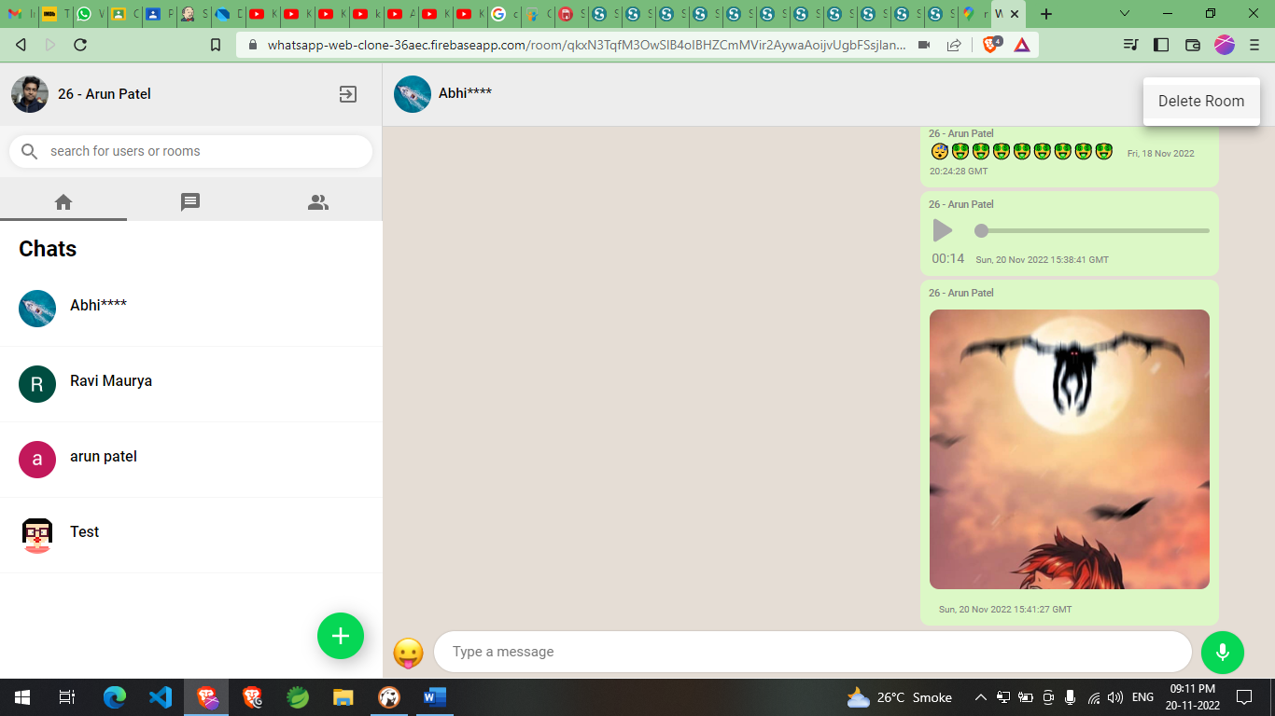
Delete Room

Slide 26
Conclusion
The entire project has been developed and deployed as per the requirements specification
Testing Strategies: - UI Testing, Integration Test, Performance Test, Manual Testing
Bug free
This design is easy to understand
And any new modules can be incorporated easily

Slide 27
Limitation And Future Enhancement
Non-Encrypted Message
Voice And Video chat
Video and File Sharing

Slide 28
Thank You

